Slide 1
An APHRC Data Science Data Pipeline
DDI2OMOP Mapping
Sentinel Surveillance
Uses HDSS sites together with the INDEPTH and/or other frameworks (like DHIS2) for CD and NCD disease surveillance
Data Warehousing
Captures households, persons, waves and their instruments as dimensions and facts in a framework aligned with the DDI Lifecycle specification
Standardization and Cross Domain Integration
Uses the OMOP CDM with its One Health exposome GIS extension
ML Prequel
Federation
Performs feature selection over OMOP to build a vector of predictors for use in No Code Low Code or the OHDSI Analytics platform
Uses ethical algorithms that balance diversity, equity and inclusion to integrate individual HDSS machine learning models
ML Experiment
ongoing
complete
in progress
in design
landscaping
With only one site or when data is pooled across sites, the pipeline stops at ML Experiment
possible PhD

Slide 2
ML Prequel
Using the OHDSI FeatureExtraction R package, we can pull covariates from the OMOP CDM for use in machine learning downstream in No Code Low Code as well as the OHDSI Data Analysis Workbench
FeatureExtraction creates “per-person covariates for a cohort of interest"
On top of these candidates, FeatureExtraction has a facility for “removing infrequent covariates, normalizing, and removing redundancy” in the use of the per-person covariates in machine learning experiments
We are going to want to grow this facility so it can perform several types of feature selection including:
Univariate feature selection,
Multivariate feature selection,
Model-based feature selection and
Iterative feature selection

Slide 3
ML Prequel (2)
This is a project with tasks and quarterly deliverables.
It will be co-developed by Letisha, Bylhah and Dora with guidance from Steve, Michael and others

Slide 4
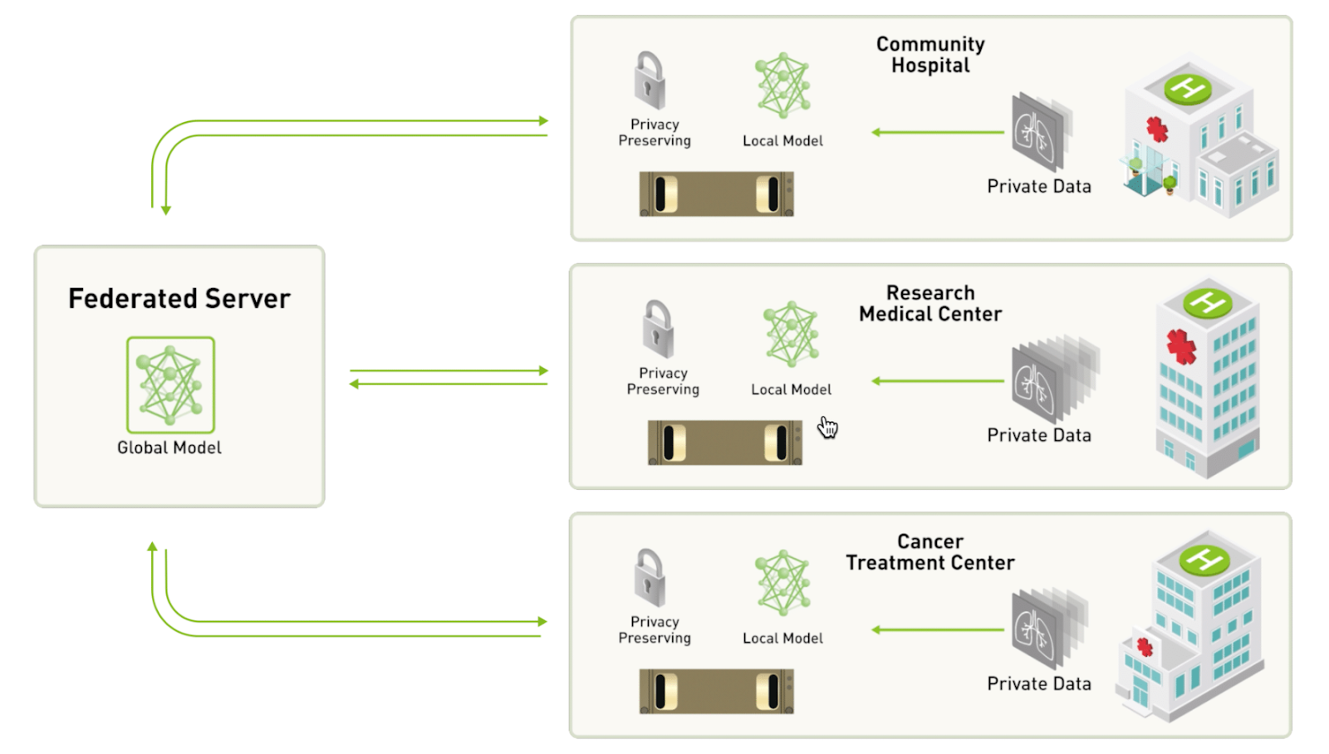
Federation
This is a project we are landscaping for use with HDSS sites and SSA research organizations
It may be developed as part of a PhD
Federated Queries
Metadata

